Slide 1
Customer Support Chatbot with Machine Learning
PIP2001 Capstone Project
VIVA-VOCE
Batch Number:144
Under the Supervision of,
Dr./Mr./Ms./Prof. Riyazulla Rahman J
Professor / Associate Professor / Assistant Professor
School of Computer Science and Engineering
Presidency University
Roll Number | Student Name
20211CSE0811 | LISHITHA K ASWATH
20211CSE0854 | DIVYA P
20211CSE0157 | SHAMBHAVI Y S
20211CSE0768 | SIRI S
Name of the Program: CSE
Name of the HoD: Dr. Blessed Prince/Dr. Robin Rohit/Dr. Asif Mohammed H.B
Name of the Program Project Coordinator: Mr. Amarnath J.L & Dr. Jayanthi. K
Name of the School Project Coordinators: Dr. Sampath A K / Dr. Abdul Khadar A / Mr. Md Ziaur Rahman

Slide 2
Introduction
The problem at hand is to create a chatbot which can interpret the customer complaints or queries, search the database for resolution and in case new solution is found, hand it over to the support staff. Based on the conversation between customer and staff, update the database, be prepared to handle similar queries in future. The primary challenge in customer support is managing a high volume of inquiries effectively. Traditional methods, which rely heavily on human intervention, can result in delays, inconsistencies, and scalability issues. This project will leverage machine learning techniques to create a chatbot that can understand and respond to a wide range of customer queries with minimal human oversight.
By analyzing historical customer interactions, this project will identify common patterns and typical queries, allowing the chatbot to be trained on a representative dataset. The implementation of natural language processing (NLP) will enable the chatbot to comprehend the context and intent of user queries, facilitating more accurate and relevant responses. This approach aims to streamline customer support processes, reduce operational costs, and improve overall user experience by providing timely and consistent answers to customer questions.

Slide 3
Literature Review
Sl.No | Title of the Paper | Authors | Technology/Concept Used | Results/Findings | Limitations/Challenges
1. | Development of An E-commerce Sales Chatbot | Khan et al. (2020) | Natural Language Processing to interact with customers. | By providing personalized product recommendations based on customer preferences and browsing history, chatbots can encourage upselling and cross-selling, boosting overall sales. | Chatbots often rely on pre-programmed responses and may struggle with understanding complex, queries. This can lead to frustration when customers ask questions outside the bot's knowledge base.

Slide 4
Sl.No | Title of the Paper | Authors | Technology/Concept Used | Results/Findings | Limitations/Challenges
2. | Customer Support Chatbot Using Machine Learning | Mohana et al. (2020) | Application of Machine Learning in enhancing customer support chatbots. | Machine learning enables chatbots to better understand and process natural language and respond to a wide variety of customer queries, even those with more complex phrasing. | Developing and training ML models for chatbots can be time-consuming and require specialized knowledge. The process may involve extensive trial and error to get the model to a functional and effective state.

Slide 5
Sl.No | Title of the Paper | Authors | Technology/Concept Used | Results/Findings | Limitations/Challenges
3. | An Intelligent Web App Chatbot | Banu et al., (2020) | Leverages LUIS’s Natural Language Processing capabilities to efficiently interpret user inputs. | LUIS uses NLP to understand and process user queries in a conversational manner, enabling the chatbot to comprehend natural language inputs, making interactions more intuitive and user-friendly. | Since LUIS operates on Microsoft's cloud infrastructure, it requires a stable internet connection and relies heavily on cloud availability. Downtime or connectivity issues can impact the chatbot's functionality.

Slide 6
Sl.No | Title of the Paper | Authors | Technology/Concept Used | Results/Findings | Limitations/Challenges
4. | Artificial Intelligence Based University Chatbot Using Machine Learning | Khan et al., (2021) | Machine Learning to streamline office operations and reduce unnecessary traffic. | By handling routine queries (e.g., information about admissions, grades, etc.), the chatbot minimizes the need for students and faculty to physically visit university offices | Chatbot can handle common queries, it may struggle with complex requests that require human expertise or personalized attention. This can result in the need for human intervention, limiting its utility in certain cases.

Slide 7
Sl.No | Title of the Paper | Authors | Technology/Concept Used | Results/Findings | Limitations/Challenges
5. | A Novel Framework for Arabic Dialect Chatbot Using Machine Learning | Alhassan et al. (2022) | Leveraging Natural Language Processing tailored to regional linguistic variations. | The chatbot is designed to understand different Arabic which is crucial in regions where Arabic is spoken. This makes more accessible to users who may not be fluent in Modern Arabic or English. | While the chatbot can effectively troubleshoot straightforward problems, it may have difficulty diagnosing or resolving complex technical issues that require deeper expertise, necessitating human intervention.

Slide 8
Proposed Methodology
Phase 1: Objective Definition & Data Collection- Define chatbot goals and functionalities- Gather historical customer interaction data.
Phase 2: Data Preparation- Clean and preprocess data- Extract relevant features (keywords, intent, context).
Phase 3: AI Model Development- Select machine learning and NLP algorithms- Train chatbot model using supervised learning.
Phase 4: Chatbot Deployment- Develop user interface and integrate with platforms- Implement NLP capabilities.
Phase 5: Performance Evaluation- Conduct functional testing- Evaluate performance metrics (accuracy, response time, user satisfaction).
Phase 6: Documentation & Reporting- Document development process and model configurations- Generate comprehensive reports.

Slide 9
Methodology
Requirement Analysis
Identify Objectives: Define the specific goals and functionalities of the customer support chatbot.
Gather Data: Collect historical customer interaction data and identify common queries and response patterns.
Data Preparation
Data Cleaning: Preprocess the collected data to remove inconsistencies, handle missing values, and format it for analysis.
Feature Extraction: Extract relevant features from the data, such as keywords, query intent, and context, to train the machine learning model.
Model Selection and Training
Choose Algorithms: Select appropriate machine learning and NLP algorithms for chatbot development, such as classification models and sequence-to-sequence models.
Train Model: Train the chatbot model using the prepared dataset, employing techniques like supervised learning and fine-tuning to enhance performance.

Slide 10
Methodology
Implementation
Develop Chatbot Interface: Create the user interface for the chatbot, integrating it with messaging platforms or web applications.
Integrate NLP Capabilities: Implement NLP algorithms to enable the chatbot to process and understand user inputs effectively.
Testing and Evaluation
Functional Testing: Conduct testing to ensure the chatbot performs as expected in handling various types of inquiries.
Performance Metrics: Evaluate the chatbot based on metrics such as response accuracy, response time, and user satisfaction.
Documentation and Reporting
Document Process: Maintain detailed documentation of the development process, model configurations, and performance evaluations.
Prepare Reports: Generate comprehensive reports summarizing the project’s outcomes, challenges, and recommendations for future improvements.

Slide 11
Objectives
Develop a Customer Support Chatbot: Design and implement a chatbot capable of automating responses to common customer inquiries using machine learning techniques.
Integrate Natural Language Processing (NLP): Employ NLP algorithms to enable the chatbot to understand and interpret the context and intent of user queries.
Enhance Response Accuracy: Implement techniques to improve the precision of responses provided by the chatbot, aiming for high relevance and reliability.
Reduce Manual Workload: Evaluate the chatbot's effectiveness in reducing the need for human intervention by managing a significant portion of customer inquiries autonomously.

Slide 12
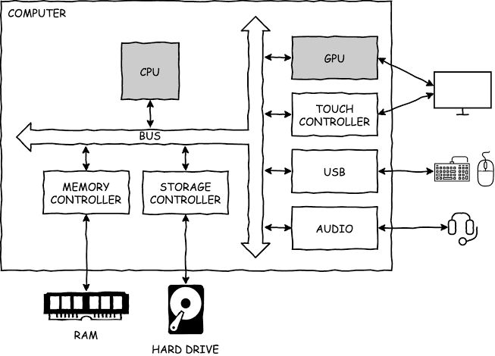
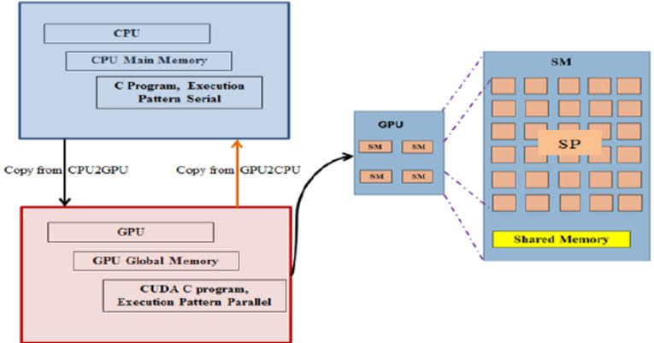
System Design & Implementation

Slide 13
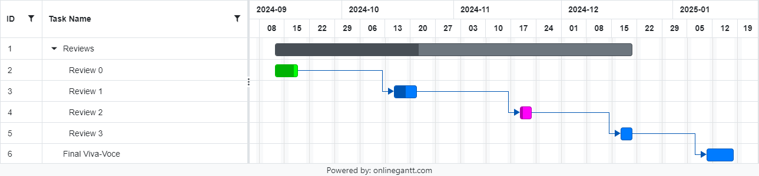
Timeline of Project

Slide 14
Outcomes/Results Obtained
Automated Response System: A functional chatbot capable of handling common customer inquiries with minimal human intervention.
Accurate Query Interpretation: Effective use of NLP to understand and interpret user queries, identifying intent and context accurately.
Seamless User Interface: A user-friendly interface for customers to interact with the chatbot through a web application.
Efficient Data Retrieval: Ability to search and fetch relevant information from the database to provide quick and accurate responses.
Performance Metrics Evaluation: Analysis of the chatbot's performance based on accuracy, response time, and user satisfaction metrics.

Slide 15
Conclusion
In conclusion, the customer support chatbot project leveraging machine learning has demonstrated significant potential to enhance user experience and operational efficiency. By automating responses and providing personalized support, the chatbot can handle a large volume of inquiries, reducing wait times and freeing up human agents for more complex tasks. The implementation of advanced natural language processing techniques has enabled the chatbot to understand and respond to a wide range of customer queries effectively.
Future improvements could include expanding the training dataset for better accuracy, incorporating more sophisticated sentiment analysis, and integrating with other support systems for a seamless customer experience. Overall, this project represents a substantial step forward in customer service innovation, offering valuable insights and laying the groundwork for further advancements in automated support solutions.

Slide 16
References
[1] Mohammad Monirujjaman Khan; "Development of An E-commerce Sales Chatbot", 2020 IEEE 17TH INTERNATIONAL CONFERENCE ON SMART ..., 2020. (IF: 3)
[2] R. Madana Mohana; Nagarjuna Pitty; P. Lalitha Surya Kumari; "Customer Support Chatbot Using Machine Learning", 2020.
[3] SHAZIYA BANU; SHANTALA DEVI PATIL; "An Intelligent Web App Chatbot", 2020 INTERNATIONAL CONFERENCE ON SMART TECHNOLOGIES IN ..., 2020.
[4] Zimal Mehboob Khan; Hafeez-ur Rehman; Maria Maqsood; Khalid Mehmood; "Artificial Intelligence Based University Chatbot Using Machine Learning", PAKISTAN JOURNAL OF ENGINEERING AND TECHNOLOGY, 2021.
[5] Nadrh Abdullah Alhassan; Abdulaziz Saad Albarrak; Surbhi Bhatia; Parul Agarwal; "A Novel Framework for Arabic Dialect Chatbot Using Machine Learning", COMPUTATIONAL INTELLIGENCE AND NEUROSCIENCE, 2022. (IF: 3)

Slide 17
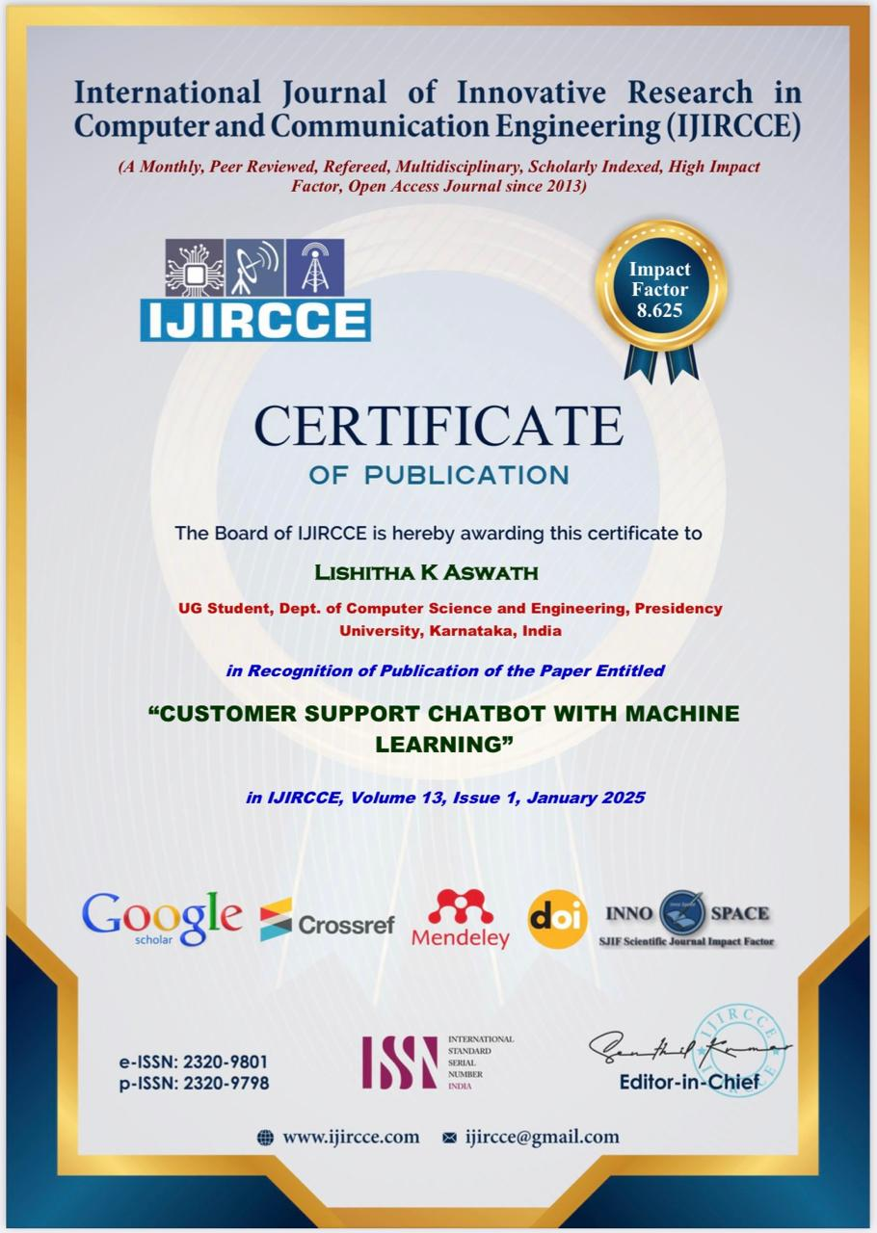


Publication Details
UGC care journal-IJIRCCE

Slide 18

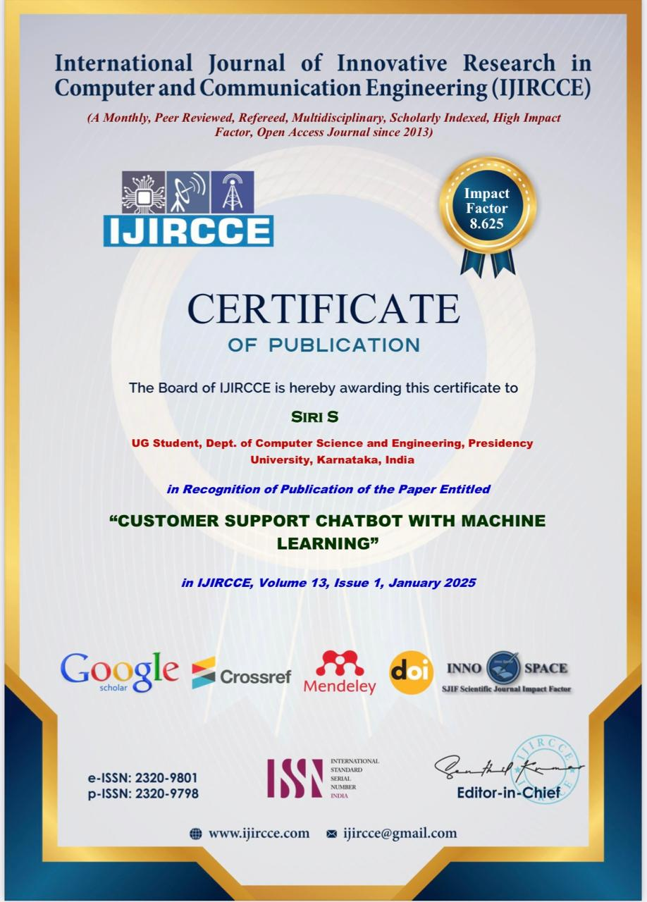

Slide 19
Thank You!

